Slide 1
TRANSFORMER LESS PV INVERTER
Project Supervisor :
Dr. Pankaj Mukhija
(Assistant Professor)
Project Team Members
Nishant Kumar (201230027)
Piyush Kumar (201230029)
Nikhil Raj (201230025)

Slide 2
CONTENTS
Introduction
Comparison
Components
Working Principle
Current Drawbacks
MPPT-Based Pv Inverter
Flowchart
Results
Conclusion
References

Slide 3

INTRODUCTION
Solar energy is a popular renewable source due to its abundance and sustainability.
PV systems convert solar energy into electrical energy using solar panels and inverters.
Traditional PV inverters use a transformer to isolate AC power from DC power.
Transformer-less PV inverters are becoming popular due to their higher efficiency, lower cost, and smaller size.
Here We will discuss the benefits and drawbacks of using a transformer-less single phase PV inverter without battery. The role of this inverter in the wider context of solar power systems will also be discussed.

Slide 4
COMPARISON
Traditional Pv Inverters | Transformer-less Pv Inverters
Requires a transformer to step up DC voltage to a level that can be used by the inverter. | Eliminates the need for transformers
Adds complexity, size, and cost to the system. | Reduces the size, cost, and complexity of the inverter system
Can lead to energy losses and reduced efficiency | Efficiency is high in Transformer-less Pv Inverters
Provides galvanic isolation for electrical safety | Can be prone to leakage current issues

Slide 5

Components
A PV (photovoltaic) inverter, also known as a solar inverter, is a device that converts the DC (direct current) electricity produced by solar panels into AC (alternating current) electricity that can be used to power household or commercial appliances and fed into the electrical grid.
These are the components of proposed Pv-inverter:-
Solar PV array
Boost Converter
H- Bridge Inverter
IGBT Driver
LCLFilter
MPPT and PWM
Load

Slide 6
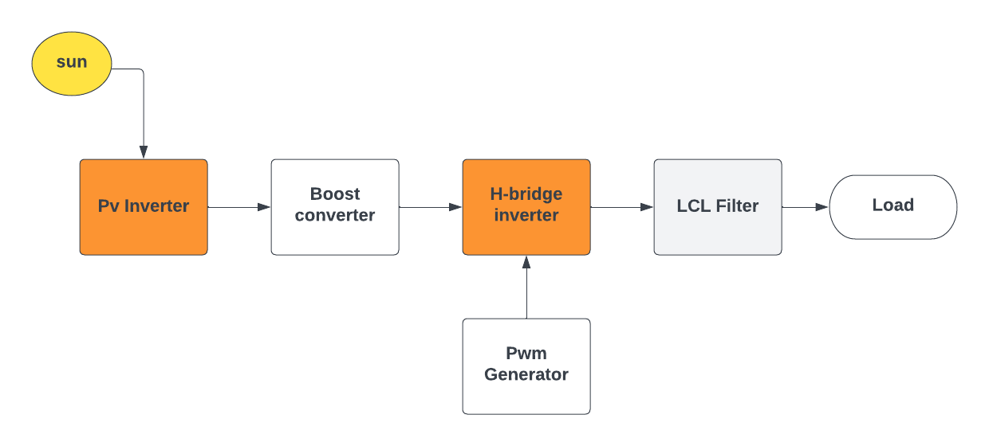
WORKING PRINCIPLE
Block diagram of Transformer-less Pv Inverter

Slide 7

CURRENT DRAWBACKS
It may produce high voltage spikes that can damage sensitive electronic devices
It may produce a square wave output that creates electromagnetic interference
More susceptible to voltage fluctuations and surges, which can lead to equipment failure.
May not be able to handle high power loads due to smaller size and lower capacity.
Boost converter can overheat and become difficult to control with only heat sinks.

Slide 8
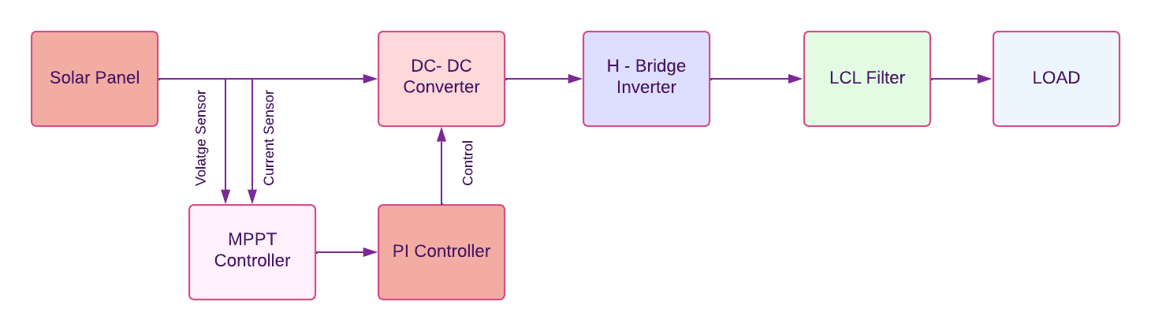
MPPT-BASED PV INVERTER
Feedback Control System for Transformer-less PV Inverters
A feedback control system has been developed to analyze and monitor the incoming voltage to outgoing voltage through the boost converter.
The control system addresses problems with transformer-less PV inverters and ensures high efficiency and low leakage currents.
The system is based on the idea of PV solar charging and has been adapted for household use.

Slide 9
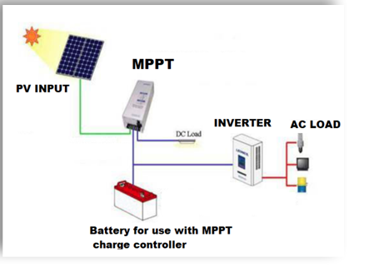
Contd…
Maximum Power Point Tracking for Solar PV Devices
The maximum power point (MPP) is the point on a current voltage (I-V) curve where the solar PV device generates the largest output.
External factors such as temperature, light conditions, and device workmanship can affect the MPP.
To ensure maximum power output (Pmax), maximum power output trackers (MPPT) regulate the resistance of the device.
MPPT systems help maintain high efficiency and maximum power output in solar PV systems.

Slide 10
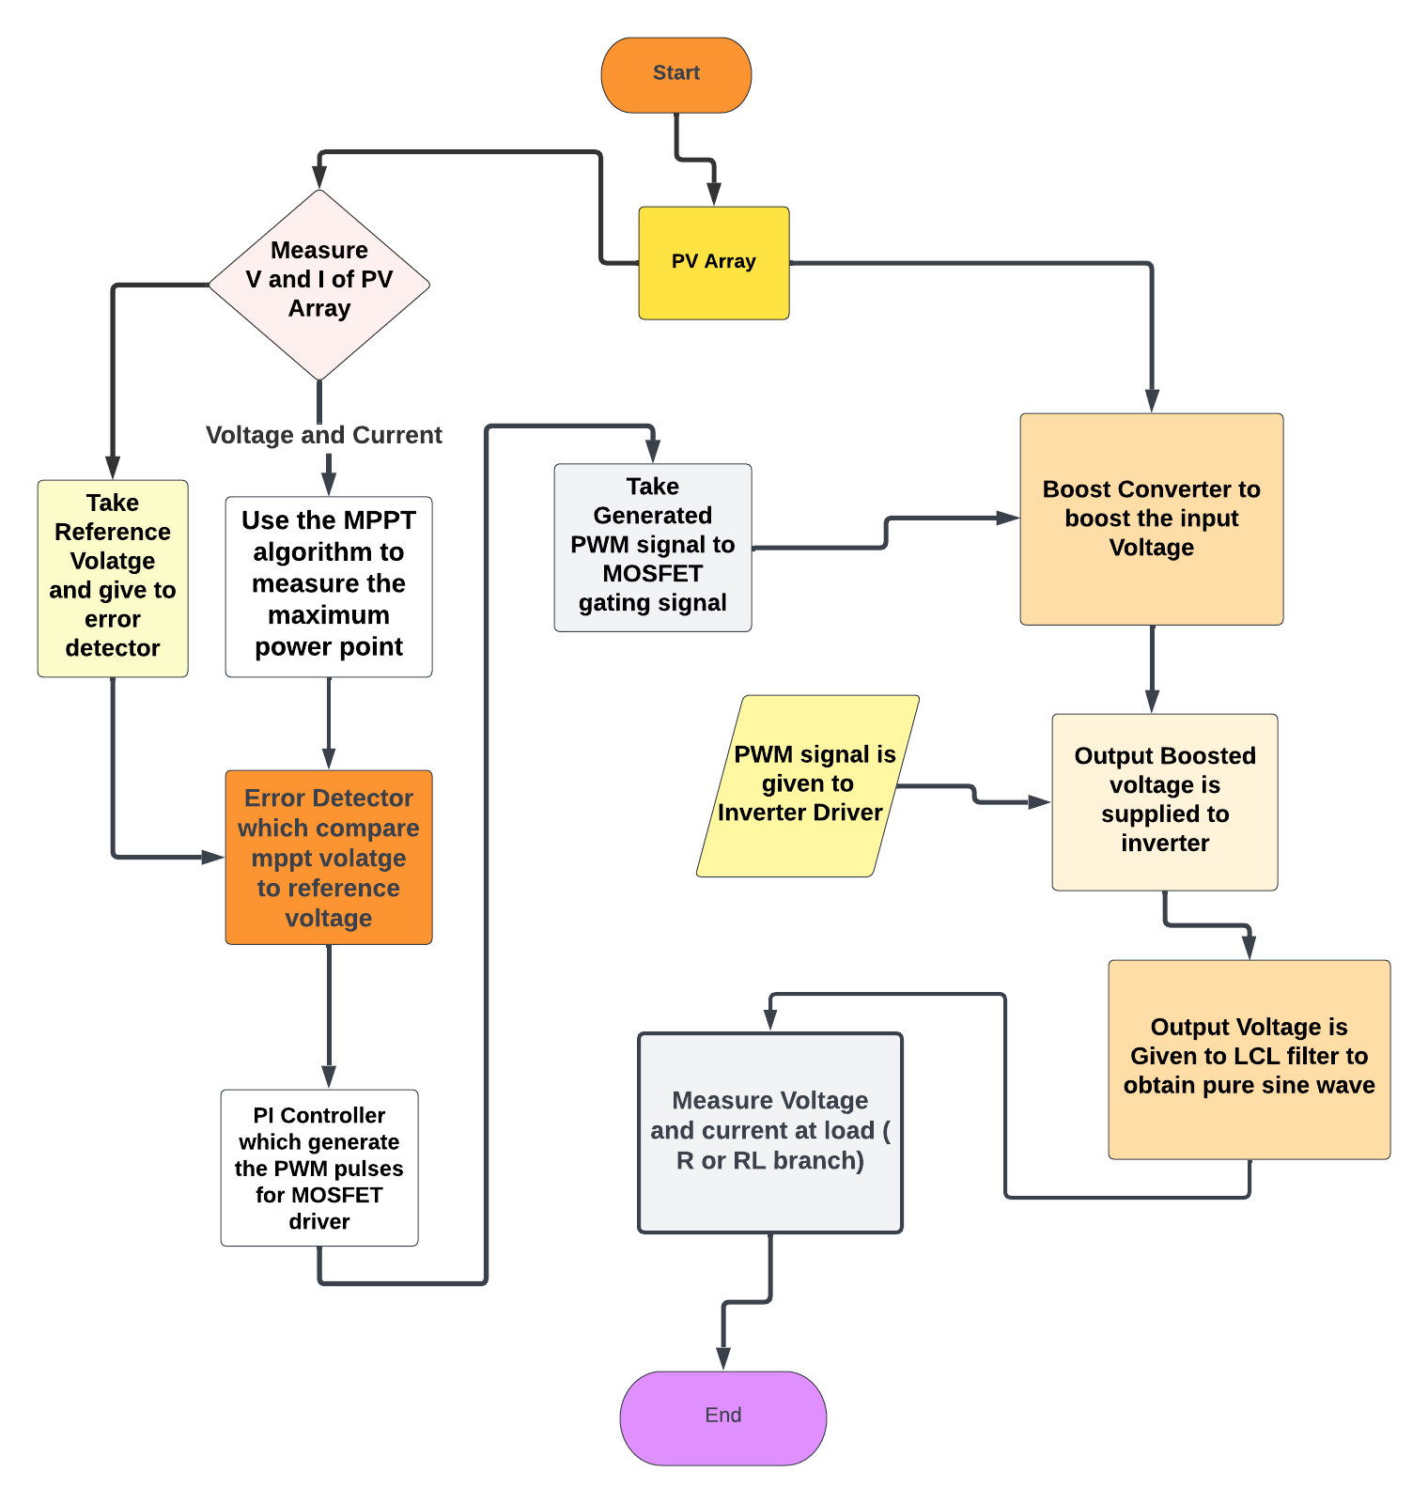
FLOWCHART OF MPPT-BASED PV INVERTER

Slide 11
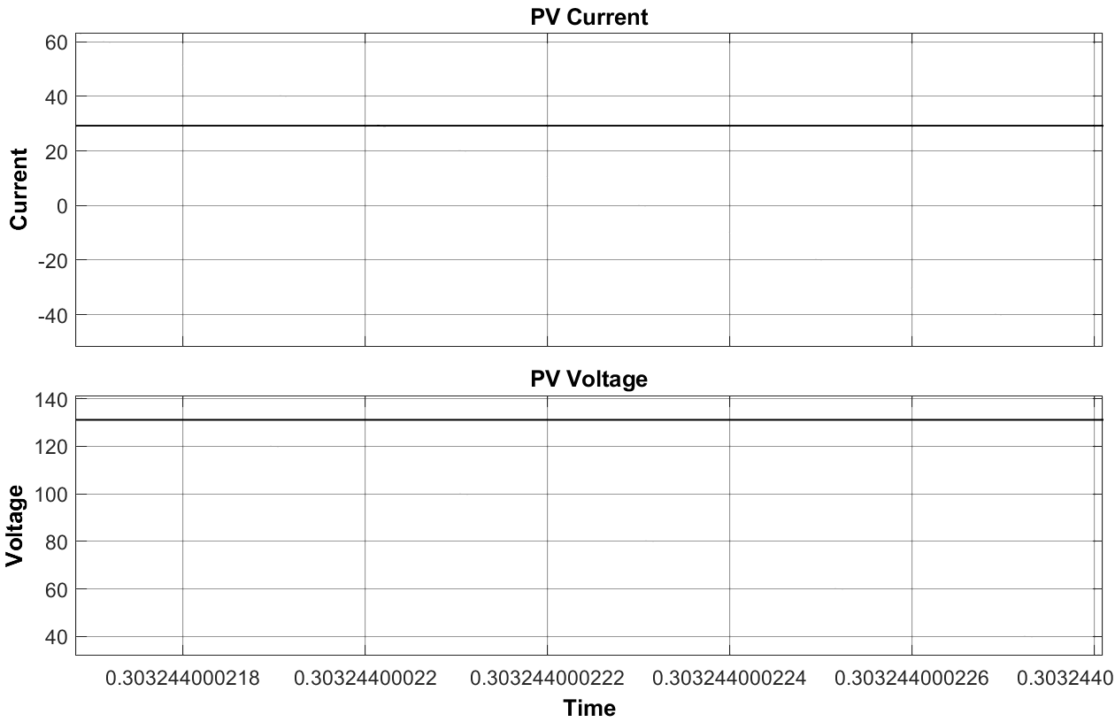
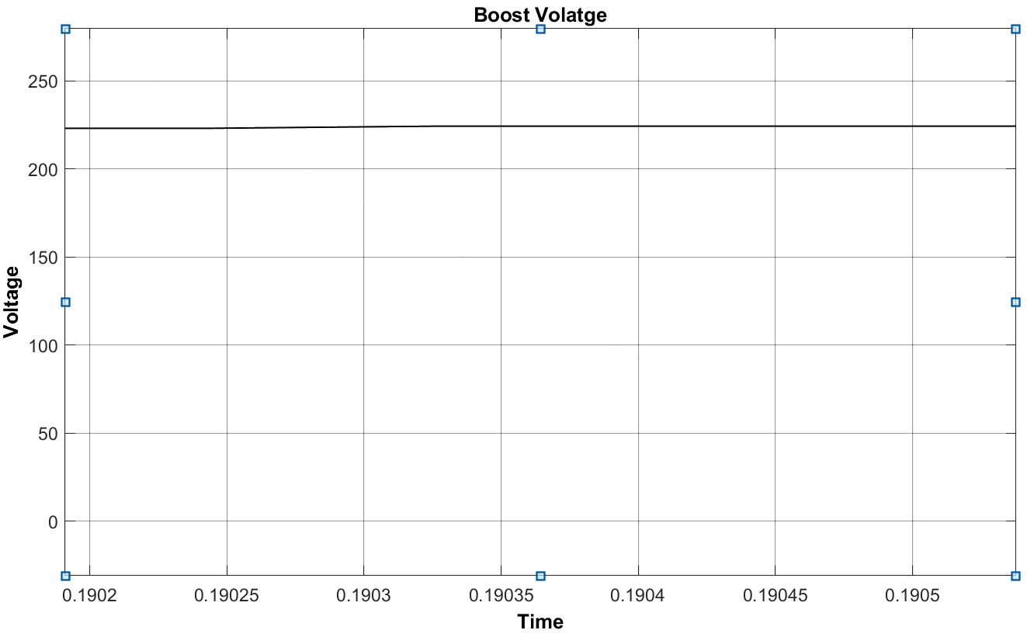
RESULTS
Current and voltage waveforms of the PV Array
voltage waveforms of the Boost converter

Slide 12
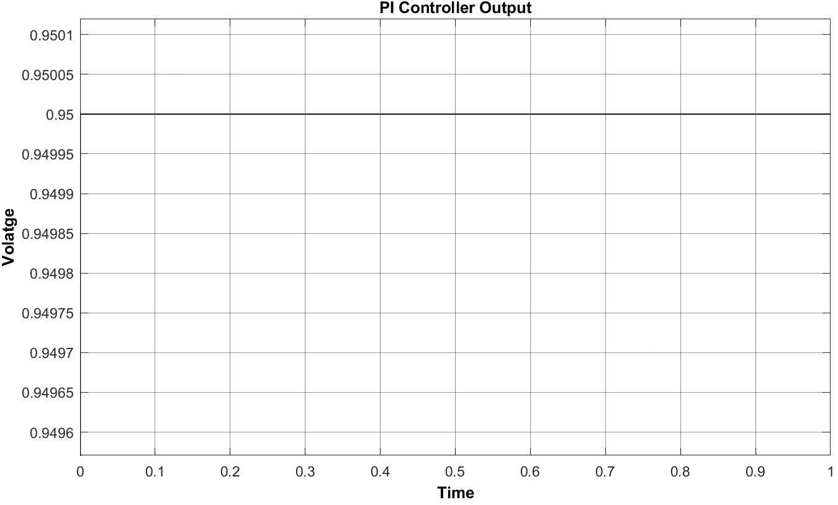
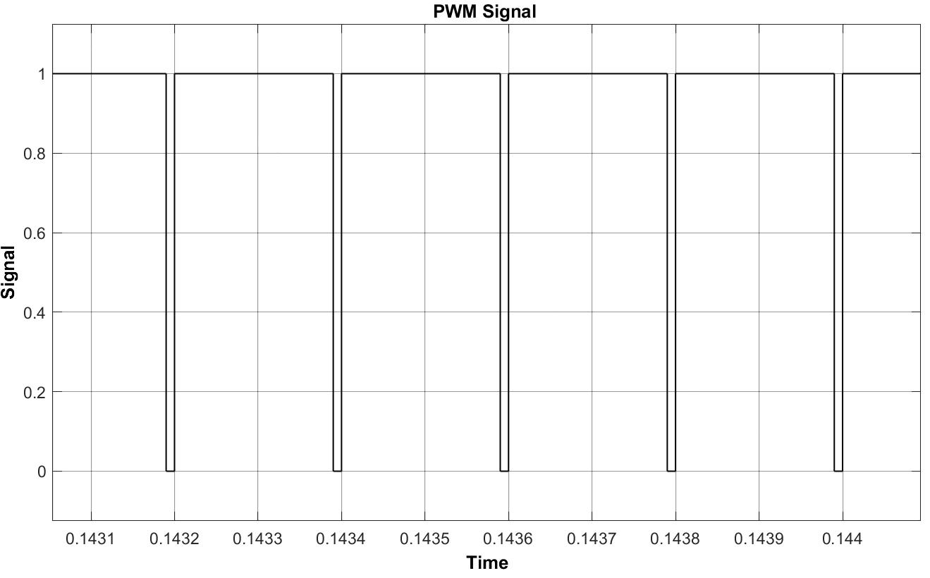
RESULTS
Output of the PI Controller
Generated PWM signal to MOSFET driver

Slide 13
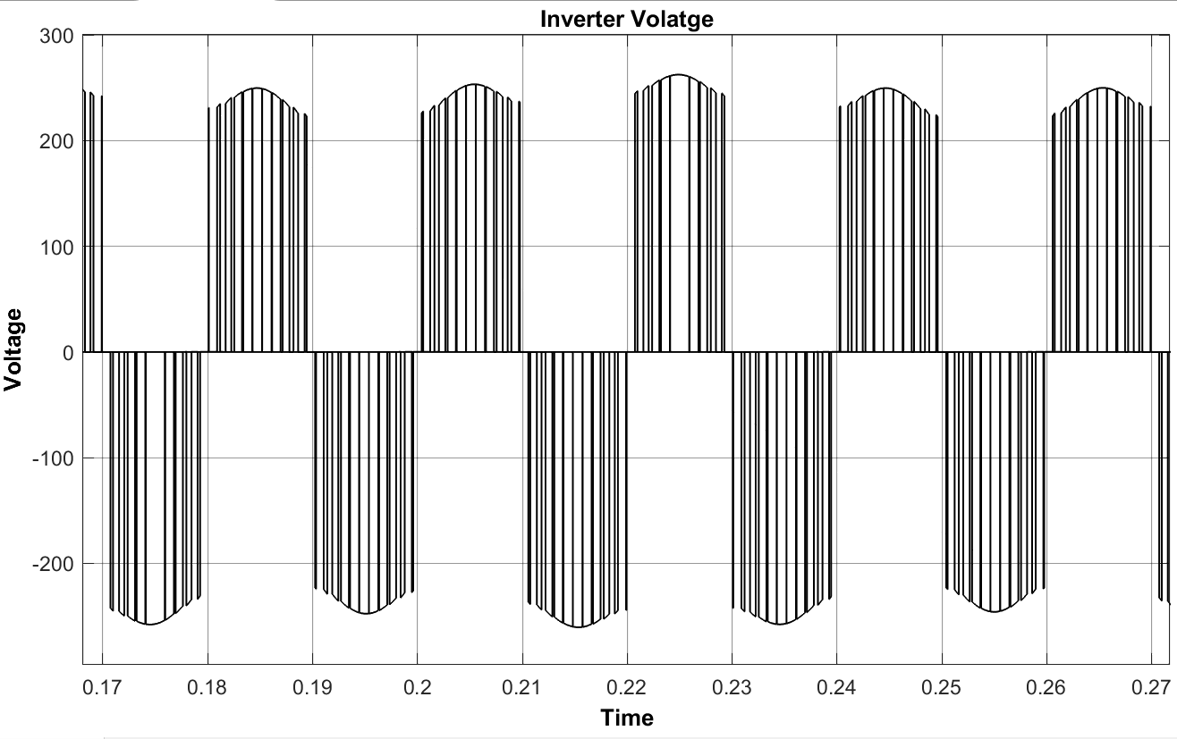
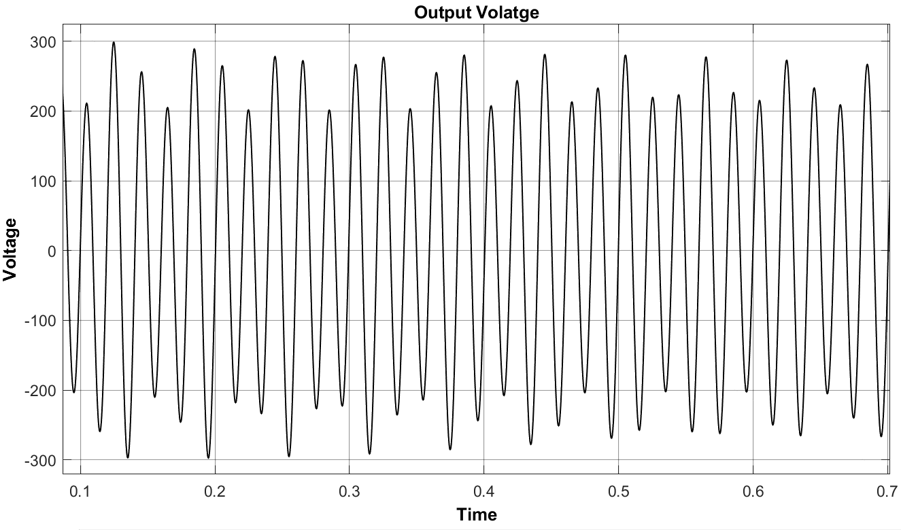
RESULTS
Voltage waveforms of the H – Bridge Inverter
voltage waveforms of the Output

Slide 14
RESULTS
The table shows the different RMS voltages for different loads. As we can see that when load resistance increases the MPPT based inverter tries to obtain optimal voltage value which is calculated using MPPT and PI controller.
LOAD | RMS OUTPUT VOLTAGE (V_{rms})
R = 200 Ω | 190.2 V
R = 500 Ω | 230.3 V
R = 1000 Ω | 221.6 V
R = 5000 Ω | 200.1 V
R = 1000 Ω , L = 100mH | 176.5 V

Slide 15

CONCLUSION
Through the Project , we have shown that a transformer-less single-phase PV inverter without battery can efficiently convert PV power into AC power while maintaining high efficiency, low leakage current, and electrical safety. Additionally, the control device used is cost-effective and can be implemented using hardware like Arduino, making it easy for monitoring and fault detection.
The designed inverter is also compatible for use with various household appliances, making it an ideal solution for domestic loads. Overall, the development of a transformer-less single-phase PV inverter without battery is a significant step forward in the pursuit of sustainable and renewable energy sources.

Slide 16
REFRENCES
Mr Umesh A. Kshirsagar, Mr Shamkumar B.Chavan, Dr Mahesh S.Chavan Design and Simulation of transformer less Single Phase Photovoltaic Inverter without battery for Domestic Application e-ISSN: 2278-1676,p-ISSN: 2320-3331, Volume 10, Issue 1 Ver. I (Jan – Feb. 2015), PP 88-93
M Geethu Chacko, Riya Scaria, An Improved Transformer Less Inverter Topology For Cost Effective PV Systems, Proceedings of 07th IRF International Conference, Bengaluru, India, 22nd June-2014, pp.170-177.
N. Surulivel and D. Debnath, "A New Switching Strategy for Improving Efficiency and Thermal Distribution of a Three-Port Converter for Solar DC Stand-Alone System," in IEEE Transactions on Circuits and Systems II: Express Briefs, vol. 69, no. 3, pp. 1527-1531, March 2022, doi: 10.1109/TCSII.2021.3131505.

Slide 17


